Slide 1



CPOL Antenna and DTMF Control Capstone Senior Design Project June 2nd, 2015
Tim Bodkin
Kevin Helms
Chris Tatosian
Luis Ceja Quiroz

Slide 2
Amatuer Radio

Slide 3
Repeaters

Slide 4
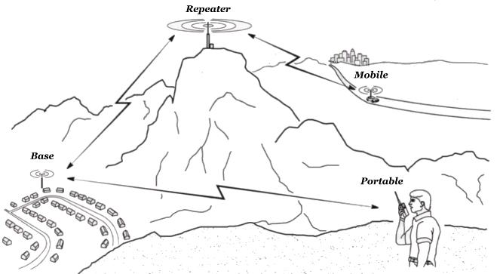
Motivation
Degraded signal integrity of the UCSC repeater due to local terrain
Provide wider range of connectivity to the repeater and Amateur Radio community

Slide 5
Solution
Circularly polarized antenna array
RoIP Nodes

Slide 6
Approach
Modular System Design
Numerical EM Code Simulation
Augmentation of UCSC Repeater System
Permanent Installation

Slide 7
System Overview
Circularly polarized antenna array
Antenna switching circuit
DTMF controller
RoIP nodes
Audio linking Interface

Slide 8
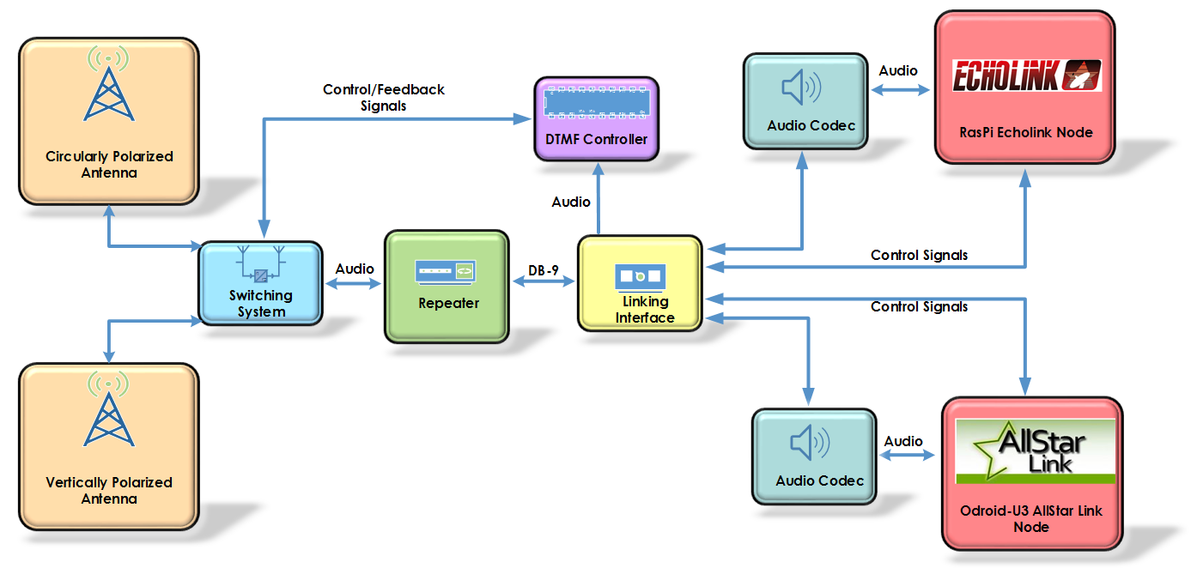
System Overview

Slide 9
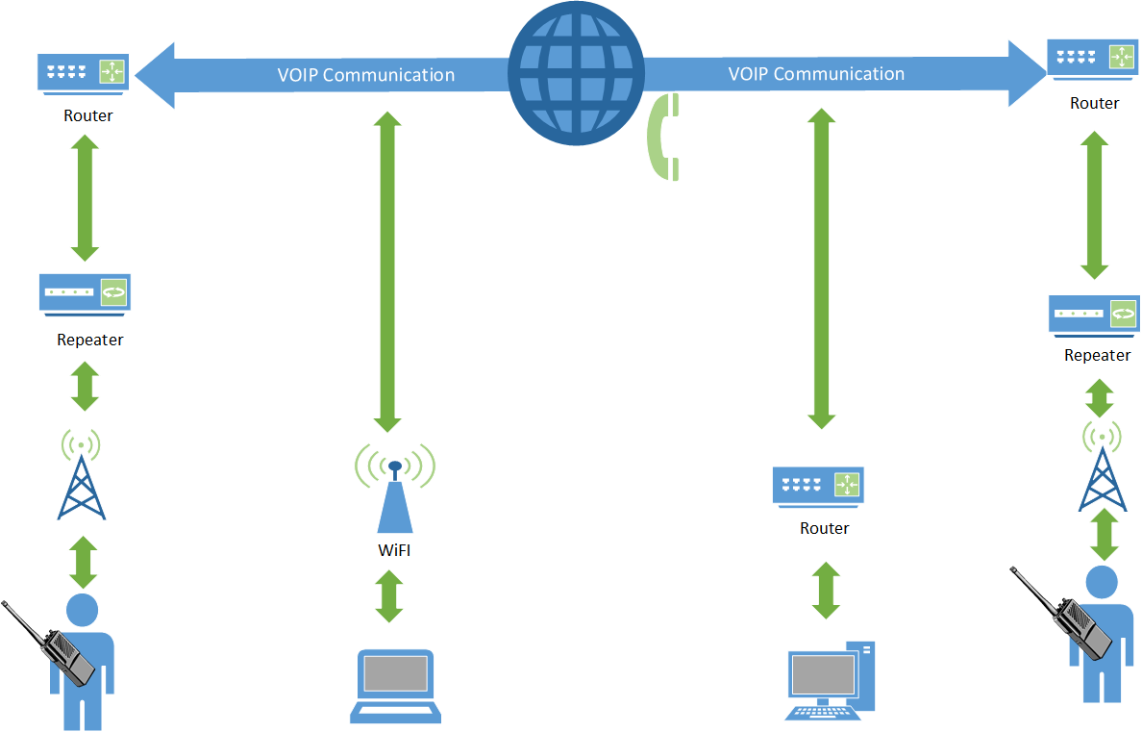
System Overview

Slide 10
Antenna Switching Circuit
System that switches active antenna
Digital control and feedback signals

Slide 11
Motivation
Real time switching between antennas
Switching event through DTMF tones

Slide 12
Initial Design and Implementation
Power supply
Coaxial relays
Power MOSFETs
Two feedback signals

Slide 13
Challenges
Rectified DC voltage higher than calculations predicted
Power resistors were found to get very hot
DTMF board can’t completely tell state of switching board

Slide 14
Final Design
Added a fan to cool
Third feedback signal added

Slide 15
Results
Seemless antenna switching
Cool LEDs

Slide 16
DTMF Controller
Overview:
The DTMF Controller acts as a central control for the antenna switching system
DECODES DTMF SEQUENCES
Logic is collected and sent between this circuit and the Linking Interface as well as the Switching Circuit
Verifies DTMF sequences through hardware and switches between the VPOL and CPOL antenna upon an appropriate sequence

Slide 17
Initial Design and Implementation
Initial Design included DTMF decoder chip MT8870 and an Atmega328P
Atmega 328P provides enough GPIO ports for desired inputs, outputs, and additional pins for future work
Atmega 328P inputs are compatible with Decoder outputs
Software
Initial design involved Pulsed inputs using AND gates

Slide 18
Challenges
Debugging
Slow Decoding/Decoder Timing
Pulsed signals had potential for timing errors, so instead designed to function with latched signals synchronous

Slide 19
FD
Final Design
Faster Decoding Time
Latched Inputs
LCD Display
Status LED’s
Manual Switch
Audible Tone

Slide 20
Echolink Overview
Open source VoIP system for amateur radio users
Originally developed for windows, but later expanded to OS X and linux
Over 200,000 validated users, about 5,000 online at any given time
Security is based on callsign validation
No known cases of malware or viruses from echolink (because it cant accept file data)

Slide 21
Echolink: Approach
Linux based single board computer (Raspberry Pi)
Software used is SVX Link, an open source VoIP software package for amatuer radio
Remote activation from field via DTMF commands
Built in DTMF decoder

Slide 22
Echolink: Initial Design
Configured in Raspbian OS
Configured static IP for SSH access on UCSC network
User interface available by SSH
Runs as a Daemon background process
Control signals configured via GPIO pins on Raspberry Pi

Slide 23
Echolink: Challenges
Controlling audio output so that both nodes can’t transmit at the same time
Customization to fit our multi-node design

Slide 24
Echolink: Final Design
Constantly running DTMF controller Echolink node

Slide 25
Echolink: Results

Slide 26
All Star Link Node
Overview
What is All Star Link?
Asterisk PBX
Licensed and validated Radio Operators
Security

Slide 27
Approach and Initial Design
IRLP
Closed source
Required purchase of their products
Odroid U3
DSP capabilities
CM 108 Audio Codec
U3 I/O Daughter Board

Slide 28
Challenges
Processing power
Software Installation
Device Driver
Little Documentation
No Support for Odroid
UDP Port Access

Slide 29
Linking Interface Overview
Central hub for all audio going between modules (DTMF controller, VoIP nodes) and the repeater

Slide 30
Linking Interface: Approach
Audio distribution amplifier for audio going to modules
Audio summing amplifier for audio going to the repeater
Embedded logic to prevent simultaneous audio transmission to repeater from VoIP nodes

Slide 31
Linking Interface: Initial Design
3.5mm mono audio jacks for audio connections
Potentiometers (logrithmic, 10k) on audio channels going to repeater to allow for gain control on individual audio channels
If one node is transmitting audio to repeater, other VoIP node is sent a ‘mute’ signal which is interpreted via a GPIO pin on each SBC, in the event that both nodes begin transmitting at the same time, Echolink is given priority
Powered off of the same 12v supply that powers the repeater

Slide 32
Linking Interface: Challenges
Control logic on first 1st rev was over complicated and needed simplification
The LM-2936 LDO didn’t give a steady 3.3v rail. Required additional capacitors to filter out high frequencies

Slide 33
Linking Interface: Final Design
Linking interface also provides power for the SBCs and DTMF controller
Linking interface has DTMF controller stacked on top of it as daughter board
Linking interface, DTMF controller, and SBCs are all within same casing

Slide 34
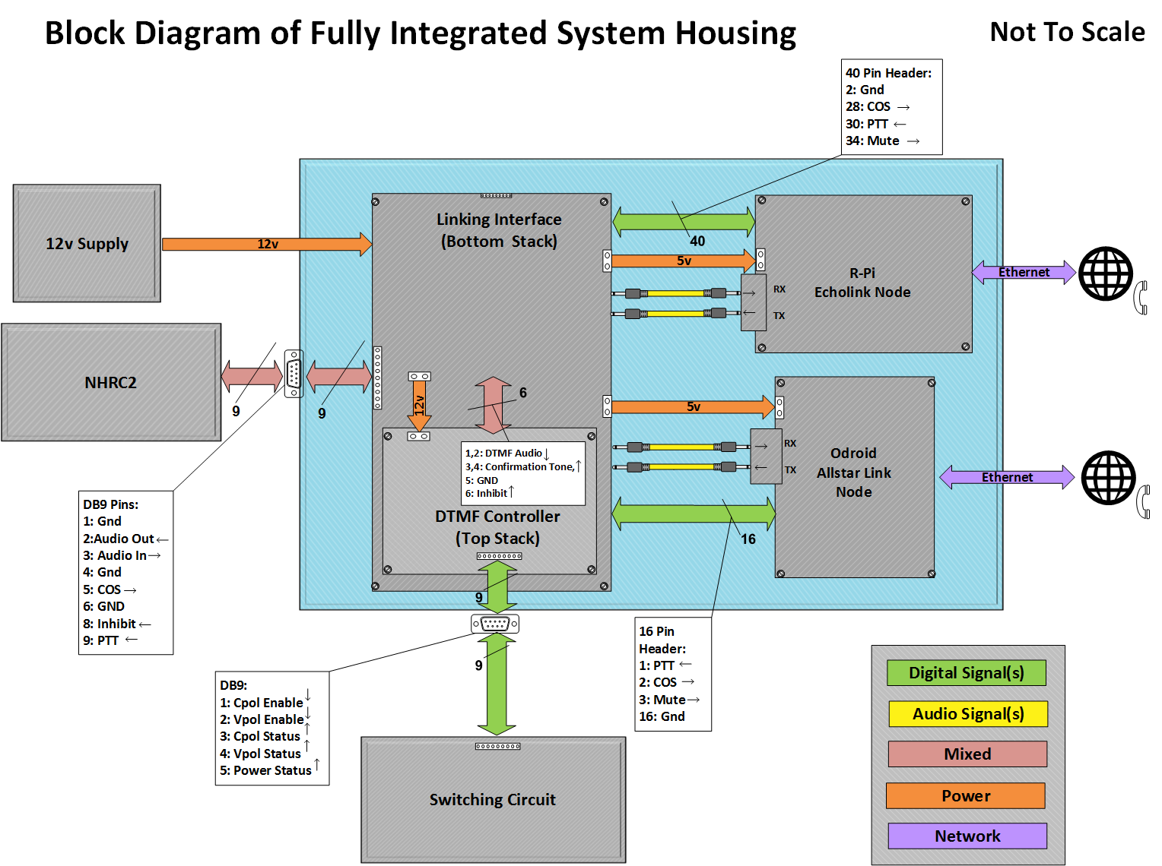

Slide 35
Future Work
Final printed circuit board fabrication
Permanent system enclosures
Mount and test mutli-element antenna array

Slide 36
Acknowledgements
Stephen Petersen (AC6Pete)
Jeff Bertalotto (KK6JGXXX)
Amateur Radio Community
Pornhub
Adderall
Vaping

Slide 37
System Demonstration

